Slide 1
Collaborative Filtering Recommendation System with Apache Spark using Scala
Ritvik Chauhan and Supriya
Team 12

Slide 2
Why Recommendation System?
A recommender system refers to a system that is capable of predicting the future preference of a set of items for a user. It is a subclass of information filtering system that seeks to predict the rating or preference a user would give to a particular item. These systems are utilized enormously across multiple industries. Recommender systems are most commonly used as playlist generators for video and music services like Netflix, YouTube and Spotify, or product recommenders for services such as Amazon, or content recommenders for social media platforms such as Facebook and Twitter.

Slide 3



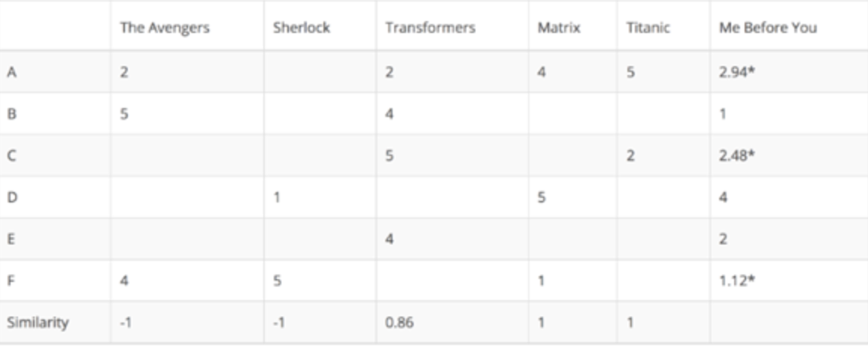
Use Cases
In This case, we aim to recommend movies to our customers.
In order to do that we will target movie ratings as a domain to find similarity between two movies

Slide 4
Methodologies
1) Content-based recommendation - analyses the nature of each item and aims to find the insights of the data to identify the user preferences
2) Collaborative Filtering - It recommends the item based on user past experience and behavior. The key idea behind Collaborative Filtering is that similar users share similar interest, people with similar interest tends to like similar items. There are two categories of CF:
· User-based: measure the similarity between target users and other users
· Item-based: measure the similarity between the items that target users rates/ interacts with and other items

Slide 5
Data Sources
MovieLens 20M movie ratings. Stable benchmark dataset. 20 million ratings and 465,000 tag applications applied to 27,000 movies by 138,000 users. Includes tag genome data with 12 million relevance scores across 1,100 tags.
https://grouplens.org/datasets/movielens/

Slide 6
Code
Construct utility matrix by Mapping input RDD with userId, ratings and movieId in following tuple `(userId, (movieID, rating))`.
Find every movie pair rated by same user, we are achieving this by using a “self-join” operation. At this point we have data in following format `(userId, [(movieId, rating), (movieId, Rating), …])`.
Filter out duplicate pairs with same movieId’s.
Out of the array of movie and ratings constructed in step 2, construct new map tuple with key as movie pair and value as respective ratings like as follows `((movieId1, movieId2), (rating1, rating2))`
Apply groupByKey() to get every rating pair found for each movie pair over the map that we have created in step 4.
From step 5 construct rating vector for each movie in pair and calculate the cosine similarity score from that vector
Sort, save or cache the similarity result for each movie pair
Set a similarity threshold and user engagement number to improve relevance of results.
Get input parameter and display results with movies names as recommendation

Slide 7
Milestones
Nov 15 -> Project Proposal Acceptance
Nov 22 ->Infrastructure ready Spark Streaming + Spark Analytics Engine
Nov 29 ->Build model
Dec 6 -> Test cases and final evaluation

Slide 8
Goal of the project
The Goal of the project is to create our own recommendation system with Apache Spark using Scala

